Slide 1
4. Choosing a Fairness metric in practice

Slide 2
Which definition to choose?
Not mathematically possible to construct an algorithm that simultaneously satisfies all reasonable definitions of a "fair" or "unbiased" algorithm [Kleinberg et al., 2016], [Chouldechova, 2017].
Deciding which definition to use must be done in accordance with governance structures.
Case-by-case basis. Often, context dictates whether the equality of opportunity or equality of outcome should be chosen.

Slide 3

Example situation: Facial Recognition
No selection process that may require equal representativeness
Ground-truth label is trusted
→ Equality of Opportunity

Slide 4

Example situation: Hiring
Algorithm selects top 100 candidates.
The problem: more white candidates selected in proportion (Disparate Impact = 0.7). But equality of opportunity metrics are good (Average odds difference).
Option 1: Do nothing (Equality of opportunity) → darker skinned candidates complain that the data used to train the model contains bias.
Option 2: Mitigate (Equality of Outcome) → a non-selected white candidate complains he was more qualified than a darker skinned candidates who was selected.
Which option to choose? How to justify a course of action?

Slide 5
Rule of thumb
If you trust the ground-truth labels→ Equality of Opportunity
If you don’t or if the label may contain bias too? Equality of Outcome or Equality of Opportunity ?

Slide 6
White
Two worldviews
Black
[Friedler et al., 2016]
Idea of construct space
Equality of Opportunity: What you see is what you get (WYSIWYG)
➔ construct space and observed space are essentially the same
Equality of Outcome: We’re all equal (WAE)
➔ Structural bias. Observed space not a good representation of construct space.
Construct space
= Ideal features
World =
Observable features

Slide 7

SAT scores
WYSIWYG: worldview says that the score correlates well with future success and there is a way to use the score to correctly compare the abilities of applicants.
WAE: worldview says that the SAT score may contain structural biases so its distribution being different across groups should not be mistaken for a difference in distribution in ability.

Slide 8
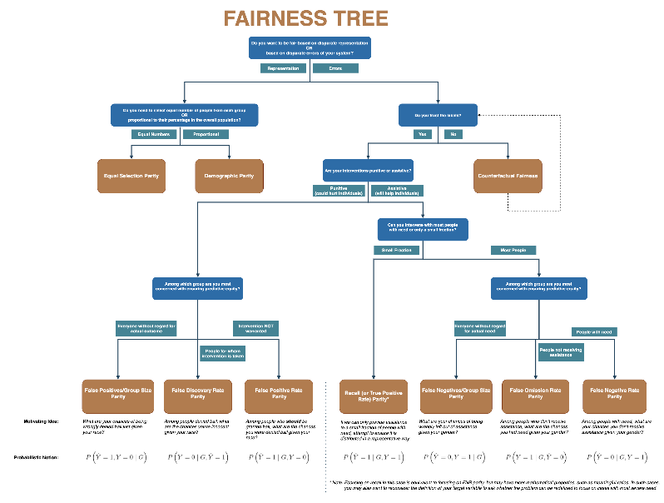
Fairness Tree
Aequitas
http://www.datasciencepublicpolicy.org/projects/aequitas/

Slide 9
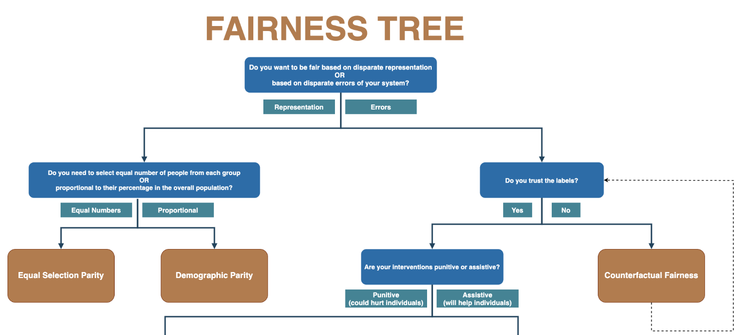

Slide 10

Conclusion

